Slide 1
Game Theory Problems

Slide 2
Class Test 3 Prob.

Slide 3
Problem 1
Consider the problem of dividing a pie between two players. If we let x and y denote player1’s and player 2’s payoffs, (x,y) is feasible if and only if x ≥ x₀ and y ≥ y₀ and x + y ≤ 1. We may interpret x₀ and y₀ as the reservation payoffs of the two players. Suppose both players simultaneously formulate demands x and y. If (x,y) is feasible, each player gets what he demanded. If (x,y) is infeasible, each player gets her reservation payoff. Find the set of Nash equilibrium of the game.

Slide 4
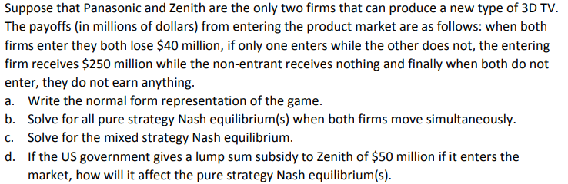
Problem 2

Slide 5
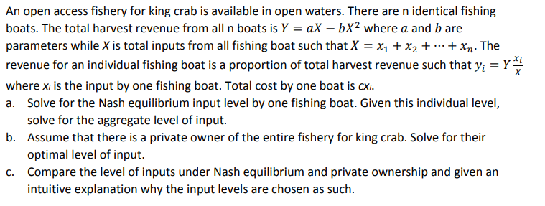
Problem 3

